Slide 1
2nd Preliminary Delivery: ChordBase
By: Naylea Trevino, Brayden Dorman, Daniel Reyna

Slide 2
Prototypes
The following few slides will show a few sketches as well as pictures of what we currently have for our website. Our main goal right now is functionality. Formatting will likely change as we progress.

Slide 3
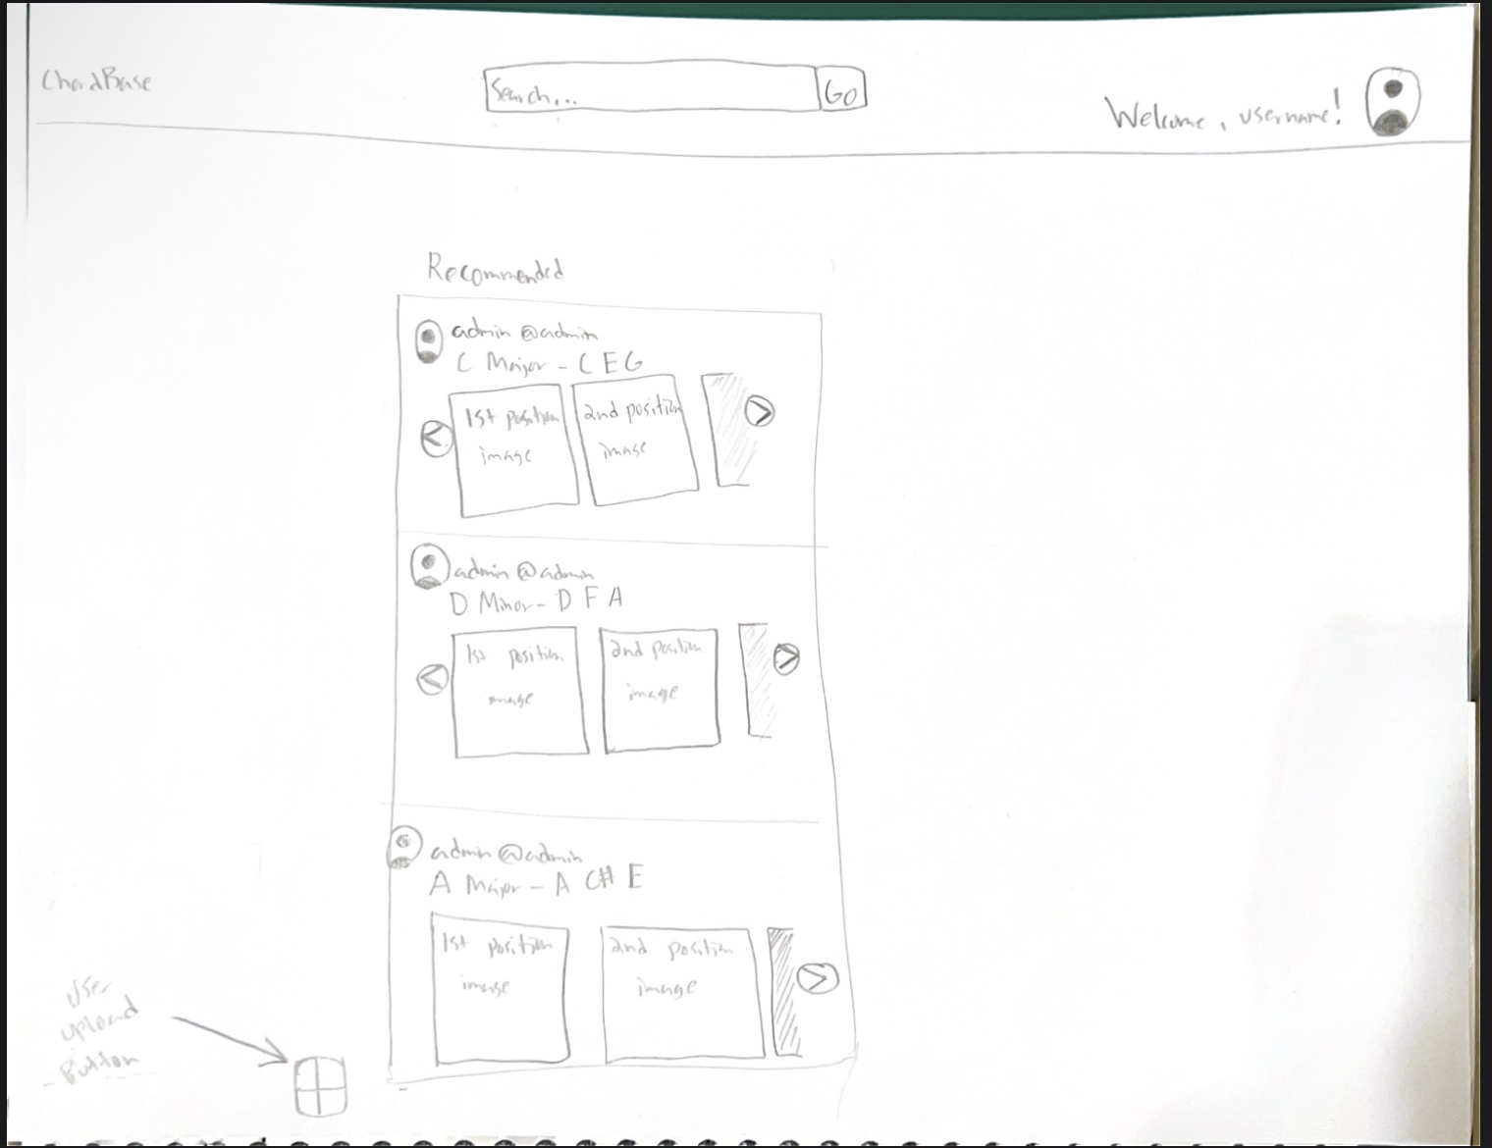
Home View/ Prototype
On the top left is the name of the app (ChordBase) that redirects users to the home page when clicked.
In the top middle is a search bar for users to find chords and accounts.
On the right is a profile icon and a welcome message that is only present when a user is logged in.
In the middle of the page is a Recommended section that acts like a For You algorithm. For new accounts it will only show admin account posts.
Lastly, on the bottom left of the Recommended feed is a user upload button.

Slide 4
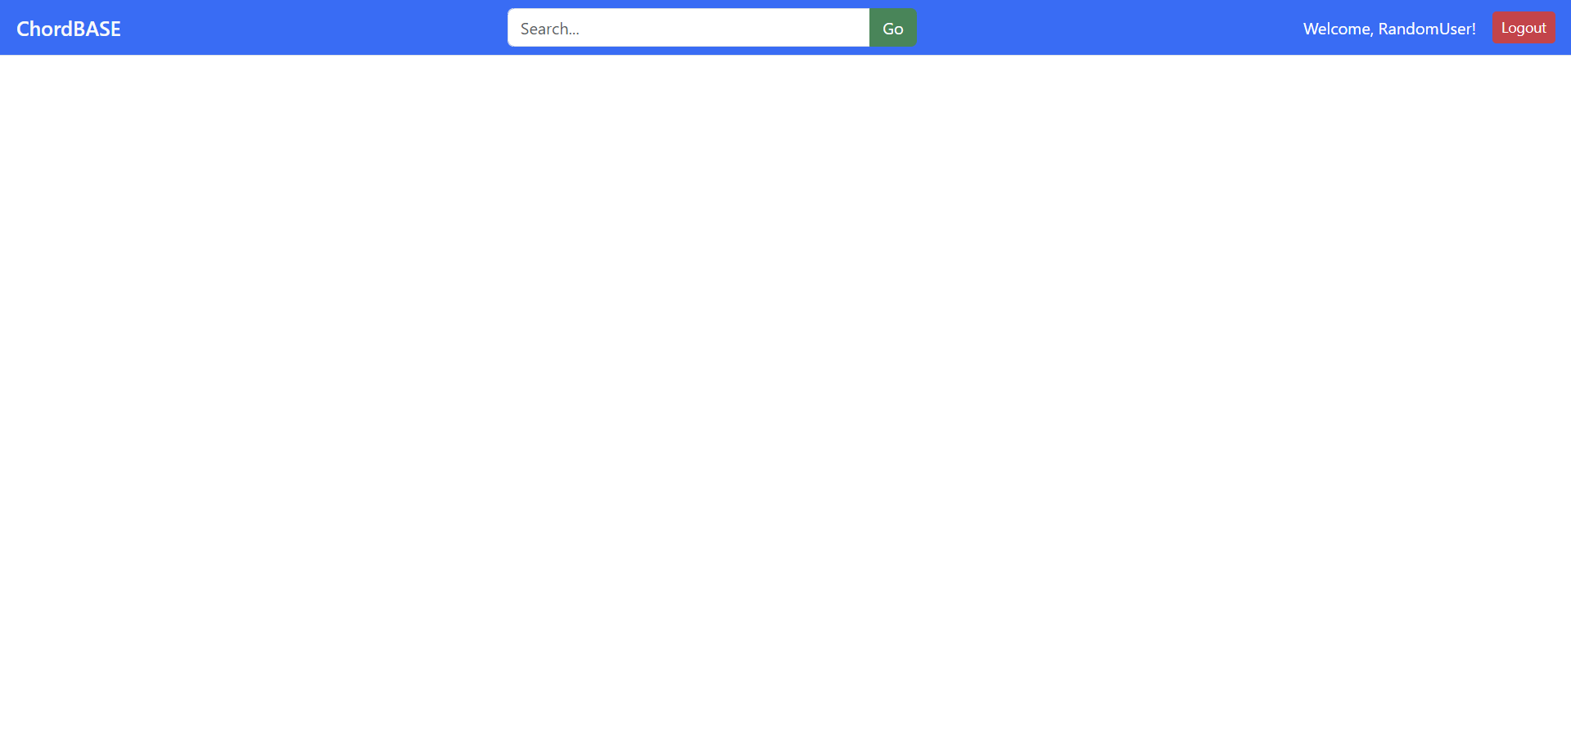
Current Home View:
- We still need to add the recommended feed, the user upload button, and the navbar profile icon

Slide 5
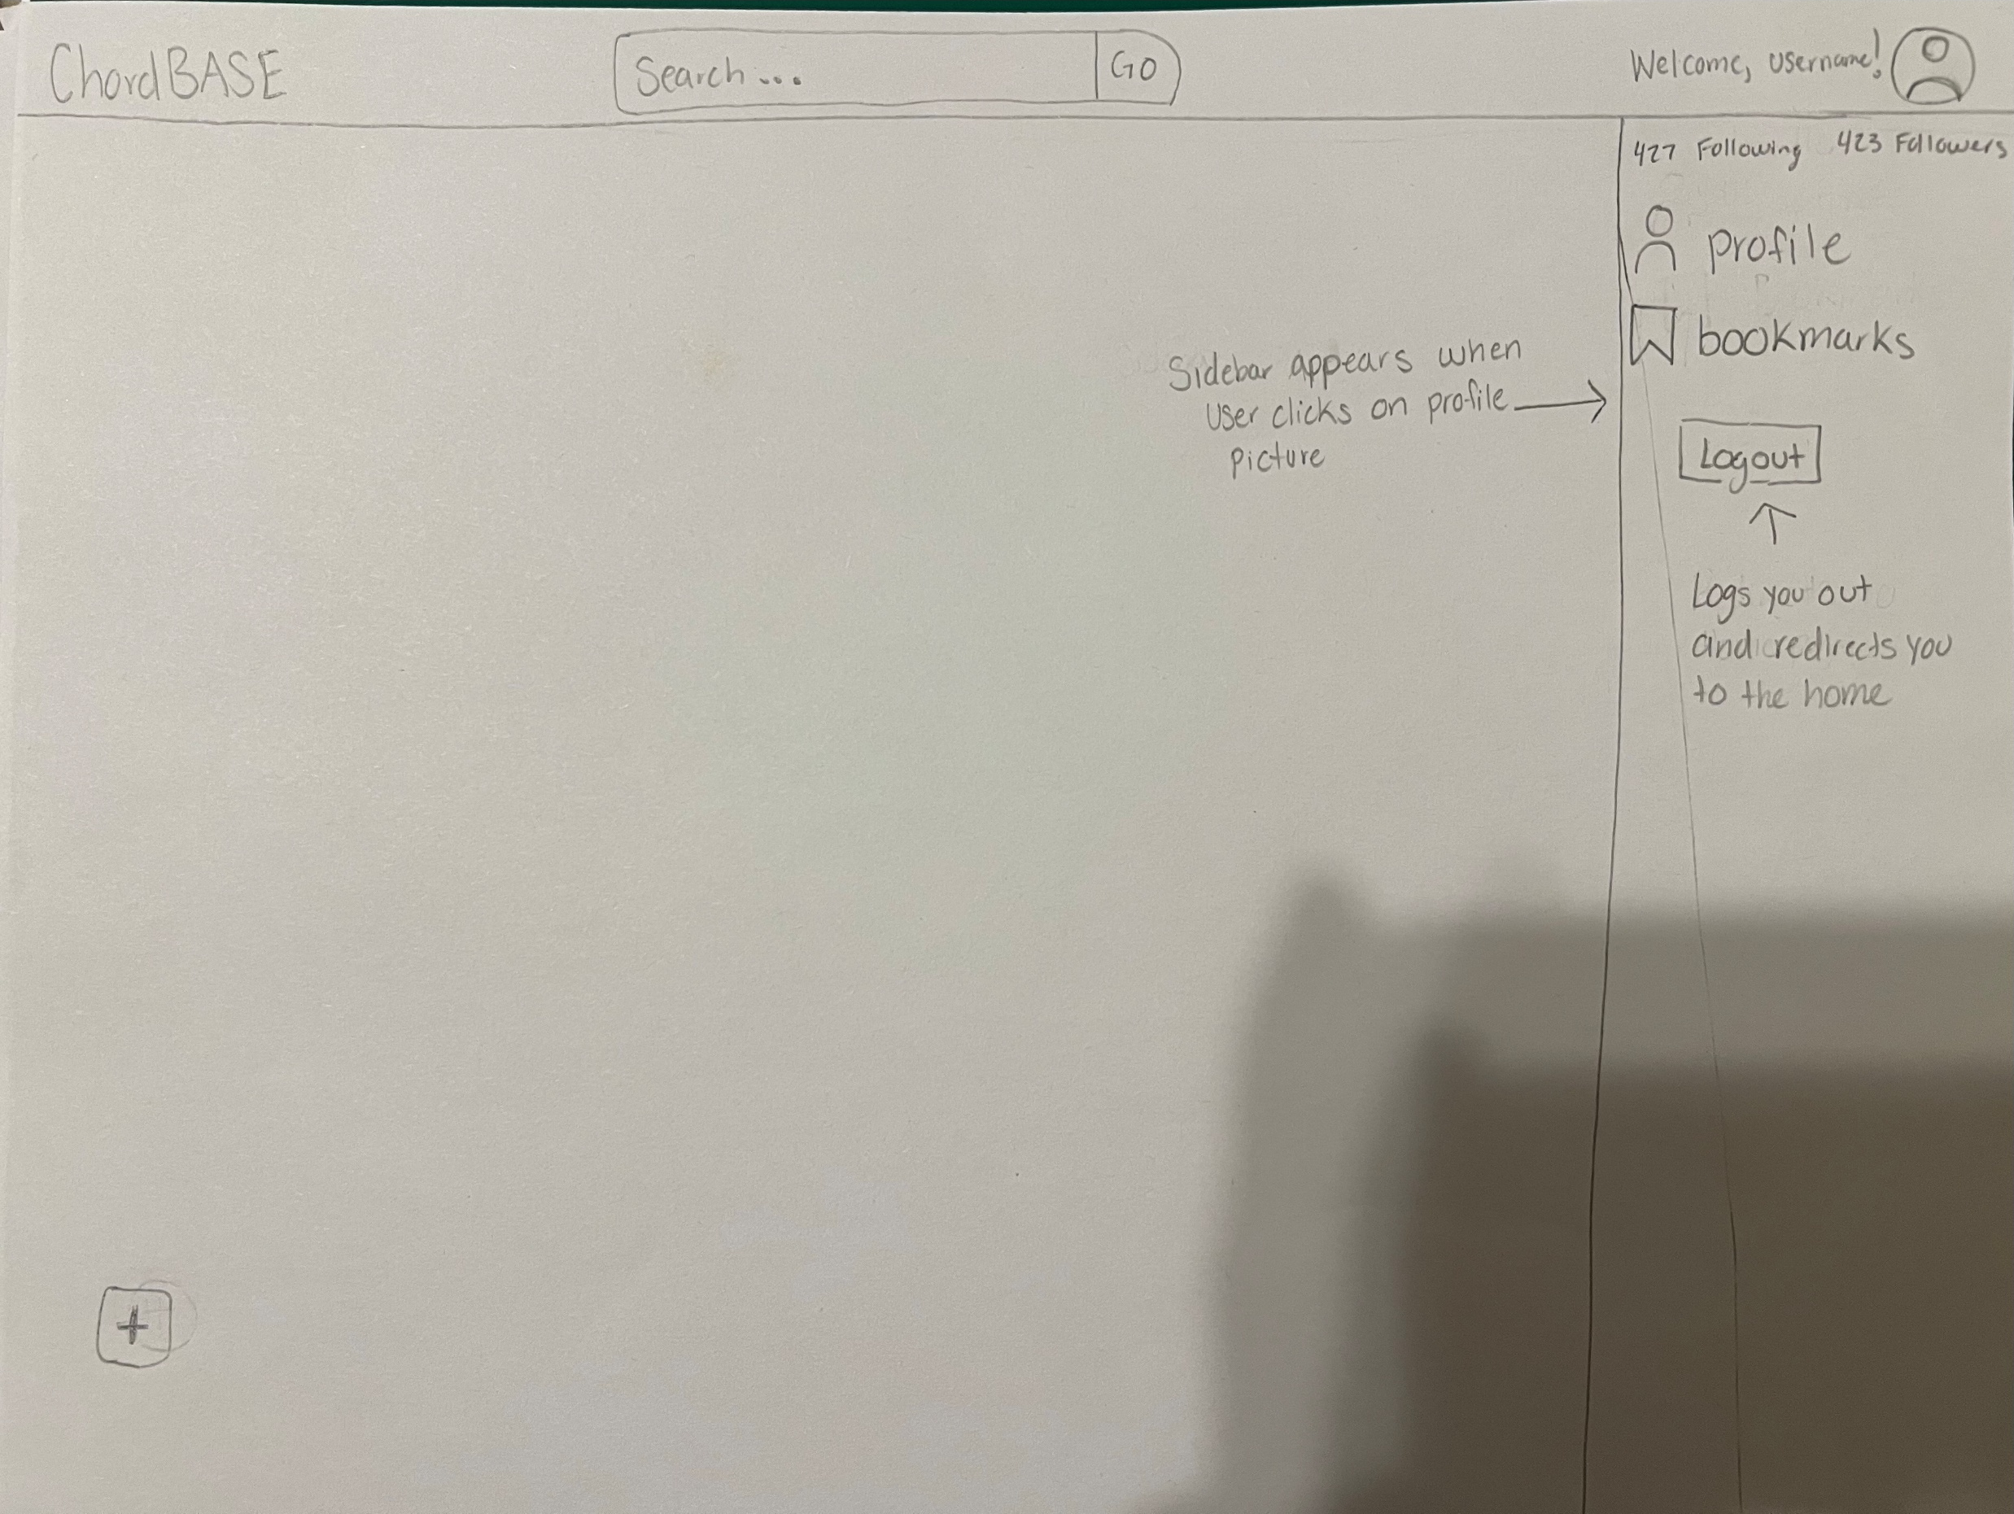
Profile Navigation Bar
There will be a dropdown when users click on the profile icon. They’ll have the ability to login/logout, check their profile, and look at their bookmarks

Slide 6
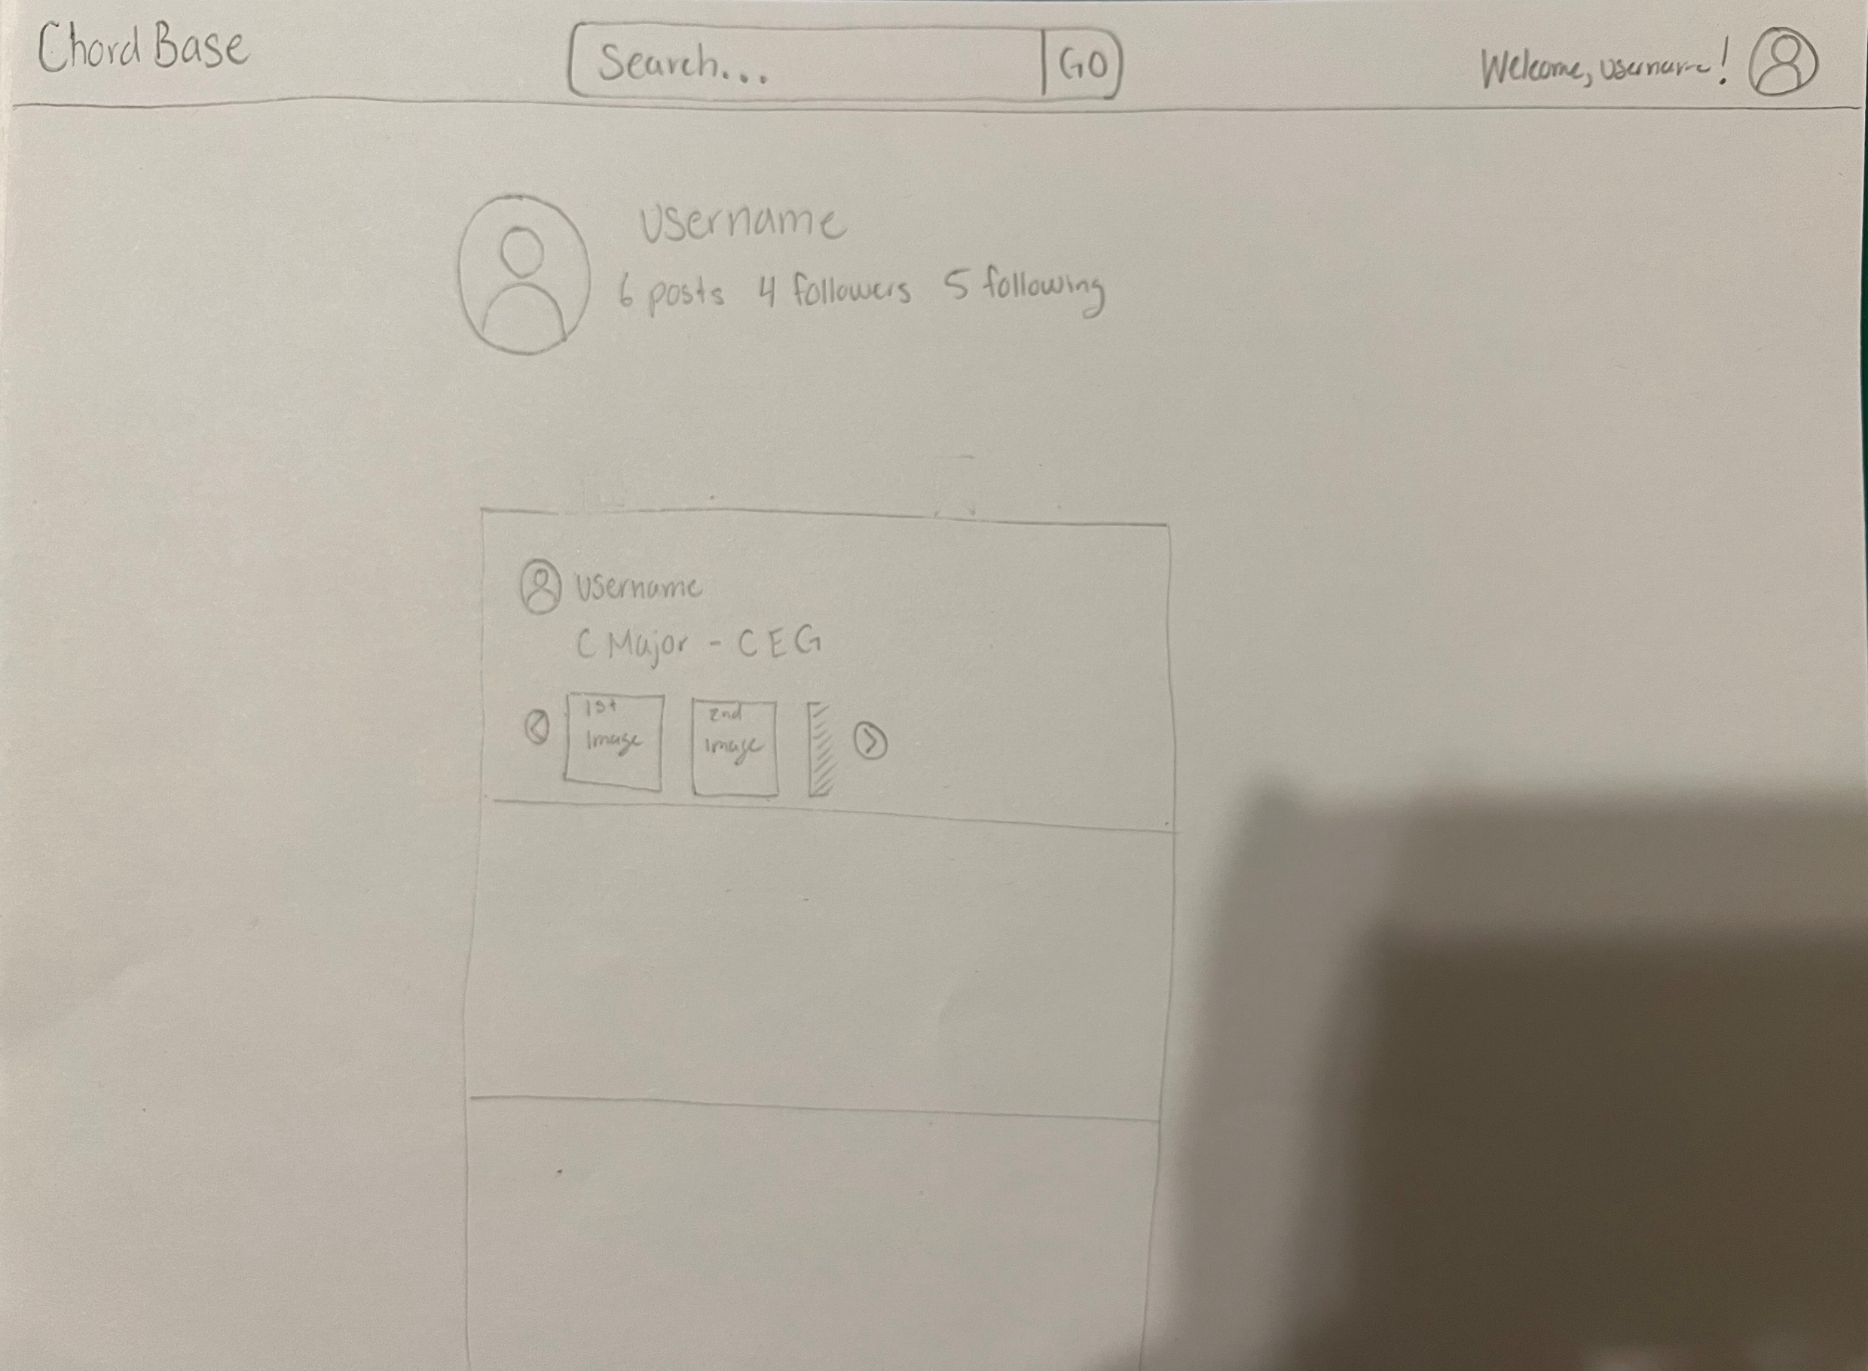
User Profile Page
On this page users will be able to see their own posts. We’re going for an approach like Instagram.

Slide 7
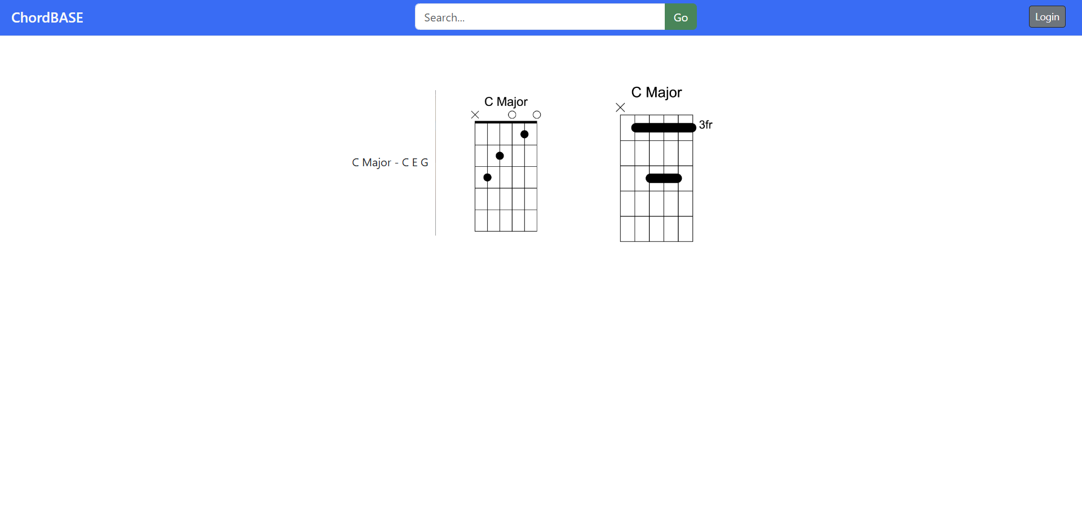
Chord Display Page After Search
We’ve already successfully added multiple images for chords, but we want them under the chord names.

Slide 8
User stories
As a beginner guitarist, I want an app that that displays how to play chords so that I can progress faster.
As an intermediate guitarist, I want to search chords that can add more nuance to my playing, so it doesn’t sound so basic.
As an advanced guitarist, I want to be able to upload tutorials for beginners so that they know how to play certain songs correctly.

Slide 9
User Management System
So far, we have a working registration, login and logout system. The next slides show how the page layouts look so far. Both the login and registration pages will be changed.

Slide 10
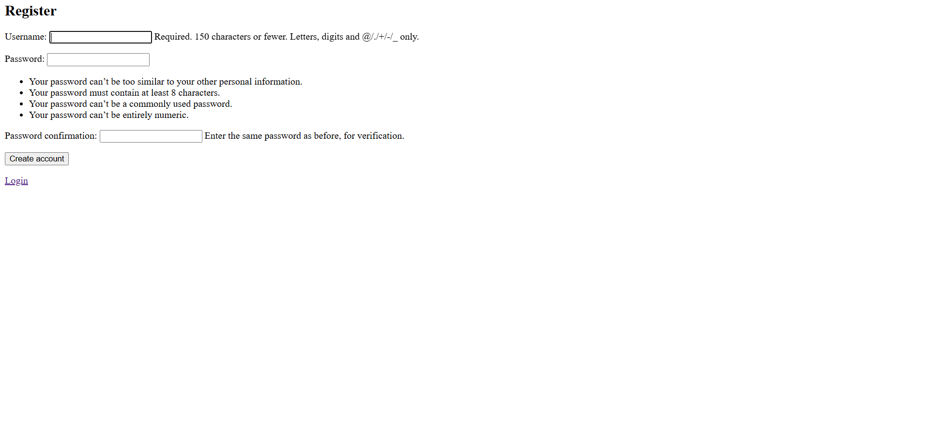
User Registration

Slide 11
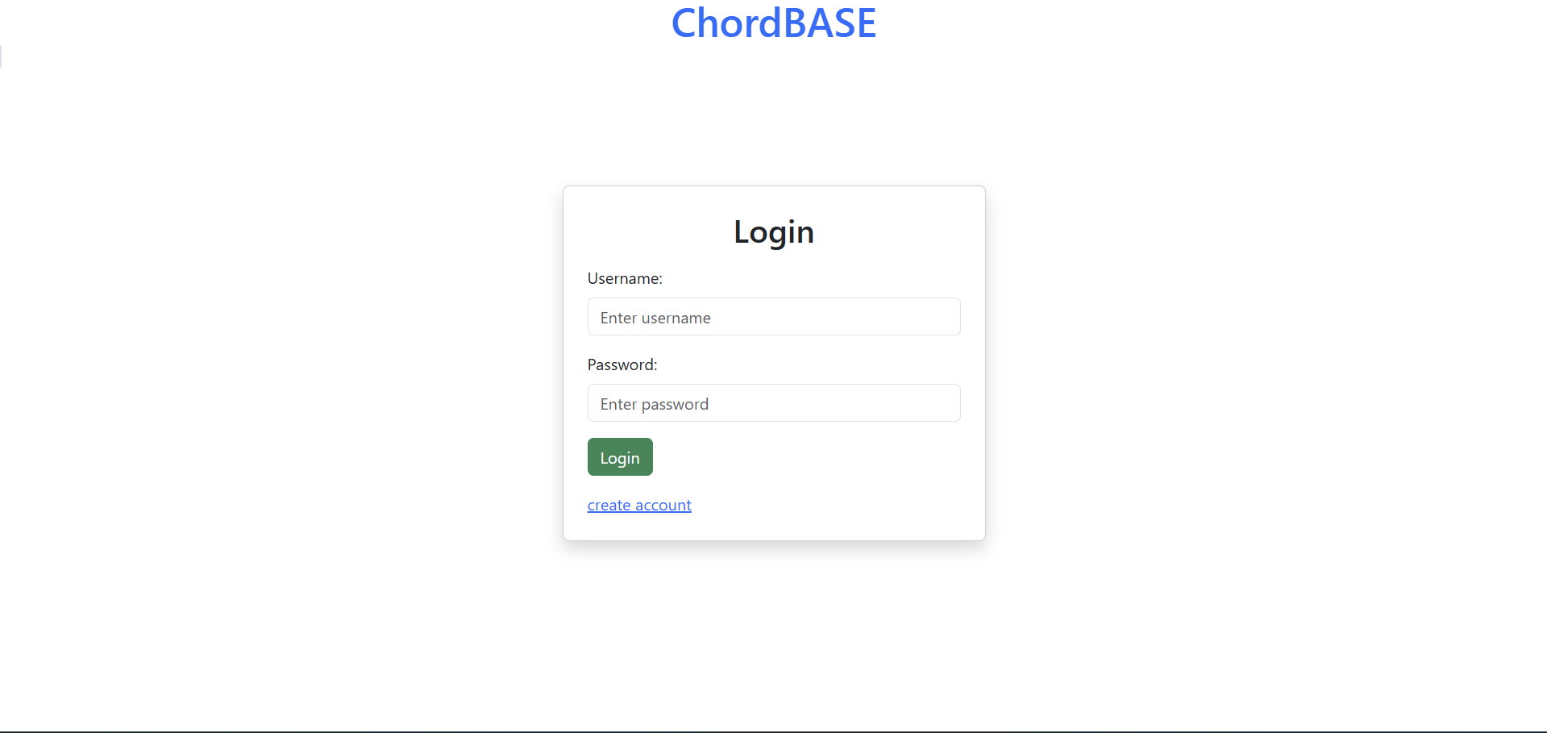
User Login

Slide 12
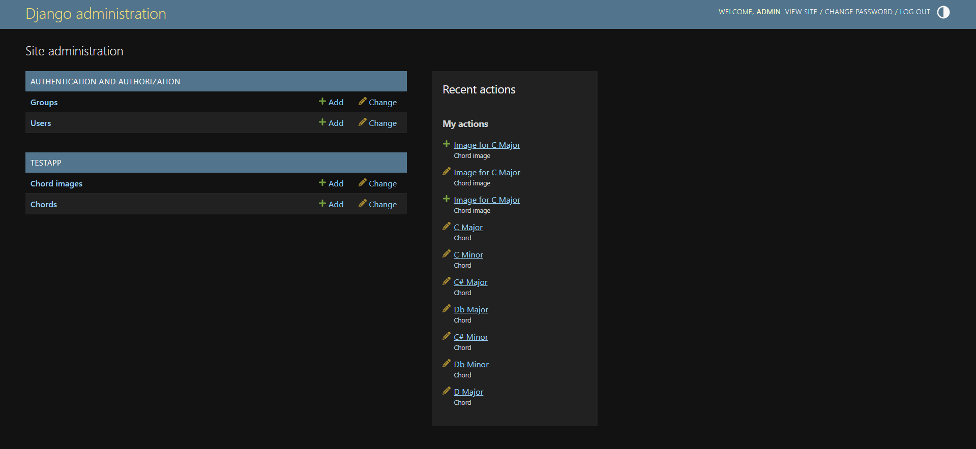
When logged in as admin we can see and modify the models in our database

Slide 13
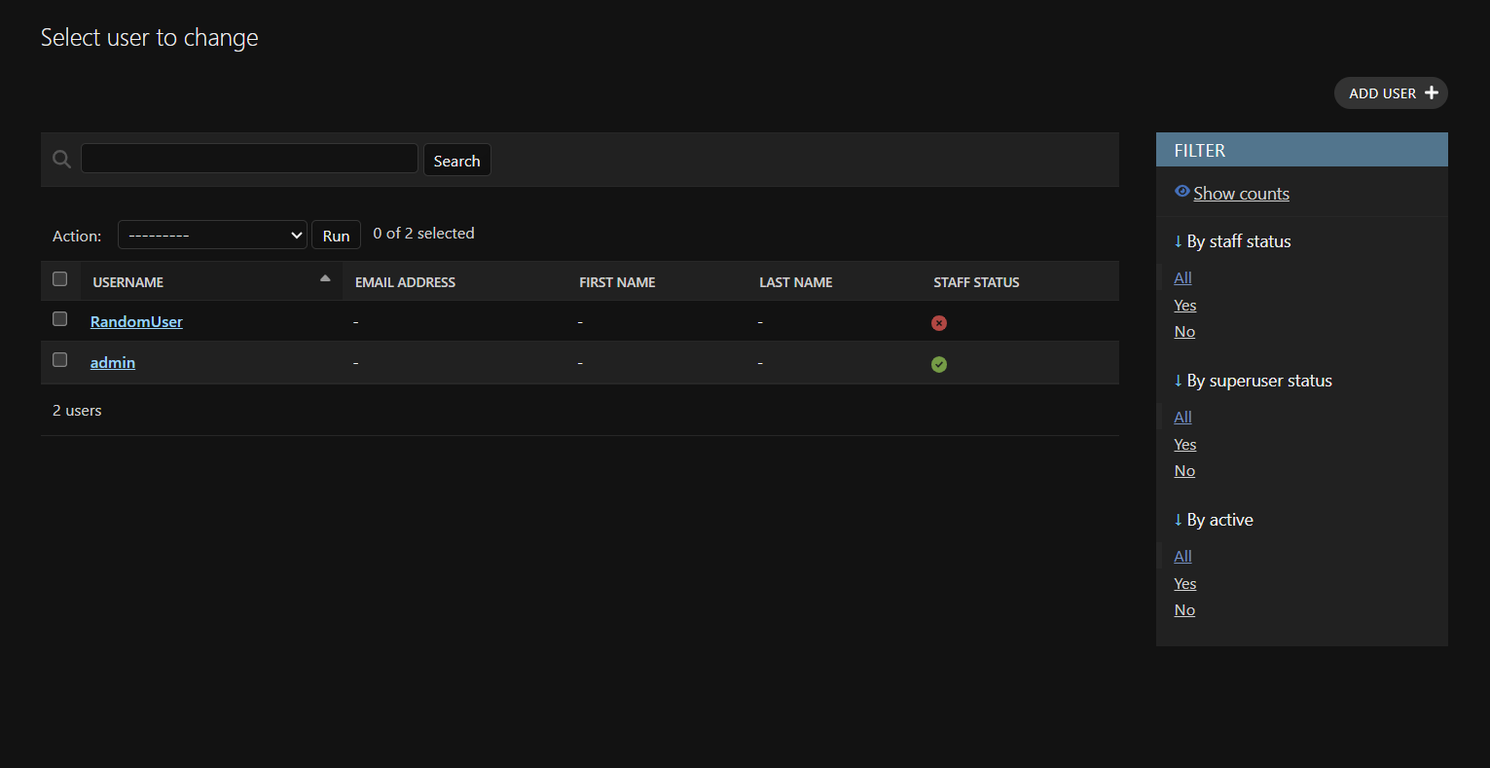
Here you can see the accounts we created are being stored properly

